Slide 1
Sentiment Analysis – Semantic orientation applied to unsupervised CLASSIFICATION OF REVIEWS
Automatically Determining Word Polarity Turney: Thumbs Up or Thumbs Down? Semantic Orientation Applied to Unsupervised Classification of Reviews
Yahia Hana Saadi Khouloud Elhamdi Kaouther Montacer Imen
A.U : 2018/2019

Slide 2
introduction
Semantic Orientation (aka sentiment polarity) : A phrase has a positive semantic orientation when it has good associations and a negative semantic orientation when it has bad associations.
Unsupervised : The approach does not learn from annotated training data, but from data that is not annotated.
Classification : Goal is to automatically assign a review one of the classes recommended (“thumbs up”) or not recommended (“thumbs down”).
The mutual information (MI) of two random variables is a measure of the mutual dependence between the two variables. More specifically, it quantifies the "amount of information" (in units such as shannons, commonly called bits) obtained about one random variable through observing the other random variable.
Notes:
Sentiment classification is a recent subdiscipline of text classification which is concerned not with the topic a document is about, but with the opinion it expresses. It has a rich set of applications, ranging from tracking users’ opinions about products or about political candidates as expressed in online forums, to customer relationship management. Functional to the extraction of opinions from text is the determination of the orientation of “subjective” terms contained in text, i.e. the determination of whether a term that carries opinionated content has a positive or a negative connotation.

Slide 3
Motivation for the Task – Applications
Classifying product reviews into recommended or not recommended
Web search engine can allow a user to narrow search to pages with positive or negative comments
Categorizing news articles into positive and negative views
Tracking of opinions for advertising campaings, public opinion, stock trading, . . .
Email Filtering

Slide 4

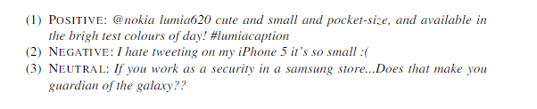
MOtivation
Twitter sentiment analysis is tricky as compared to broad sentiment analysis because of the slang words and misspellings and repeated characters.
this abundance of data has quickly attracted business and research in-terest from various ﬁelds including marketing, political science, and social studies,among many others, which are interested in questions like these: Do people likethe new Apple Watch? What do they hate about iPhone6? Do Americans supportObamaCare? What do Europeans think of Pope’s visit to Palestine? How do we rec-ognize the emergence of health problems such as depression? Do Germans like howAngela Merkel is handling the refugee crisis in Europe? What do republican votersin USA like/hate about Donald Trump? How do Scottish feel about the Brexit?

Slide 5
SO-PMI
The PMI-IR algorithm is employed to estimate the semantic orientation of a phrase (Turney, 2001). PMI-IR uses Pointwise Mutual Information (PMI) and Information Retrieval (IR) to measure the similarity of pairs of words or phrases.

Slide 6
Approach
Three steps for classifying a review
1. Identify phrases that contain sentiment.
2. Determine the semantic orientation of all phrases.
3. Classify complete review.

Slide 7
Step 1: Identify Phrases
Adjectives are good indicators of sentiment.
Isolated adjectives may be insufficient (“unpredictable” is positive in “unpredictable plot” but negative in “unpredictable steering”).
Adjectives and adverbs are extracted with one following word for context.

Slide 8
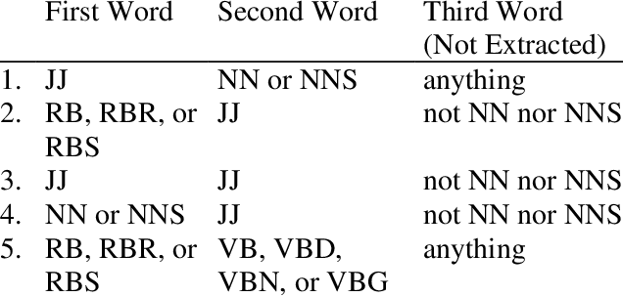
POS Tag Patterns for Phrases
Notes:
Two consecutive words are extracted from the review if their tags conform to any of the patterns in Table 1. The JJ tags indicate adjectives, the NN tags are nouns, the RB tags are adverbs, and the VB tags are verbs. 4 The second pattern, for example, means that two consecutive words are extracted if the first word is an adverb and the second word is an adjective, but the third word (which is not extracted) cannot be a noun. NNP and NNPS (singular and plural proper nouns) are avoided, so that the names of the items in the review cannot influence the classification.

Slide 9
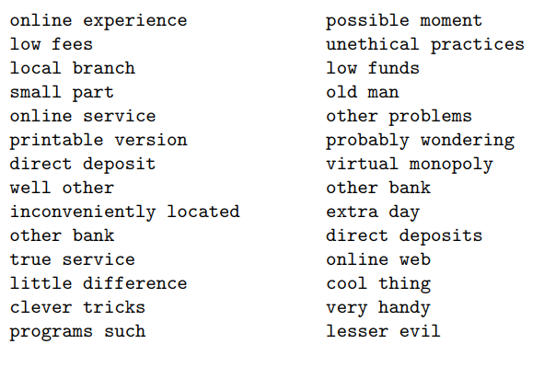
Example Phrases

Slide 10
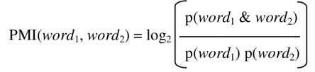
Pointwise Mutual Information (PMI)
The strength of association of a phrase with a word (A) can be determined using pointwise mutual information (PMI).
PMI(Pointwise Mutual Information) is defined as :
PMI is :
= 0 if word1 and word2 are independent. > 0 if word1 and word2 often occur together. < 0 if word1 and word2 seldom occur together.

Slide 11
Determine Semantic Orientation
The semantic orientation of a phrase is its strength of association with a positive word (“excellent”) minus its strength of association with a negative word (“poor”):
SO(phrase) = PMI(phrase, “excellent”) - PMI(phrase, “poor”)
If SO is :
> 0 the phrase has positive semantic orientation. < 0 the phrase has negative semantic orientation.
The absolute value of SO gives the strength of the orientation.

Slide 12
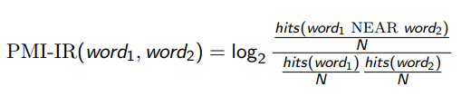
Calculating PMI with a Search Engine
Use the NEAR operator of the AltaVista search engine.
NEAR constrains the search to documents that where both words occur within 10 words of each other (in either order).
Let hits(q) be the number of hits returned by the query q.
Let N be the number of indexed pages.
PMI-IR is then:

Slide 13
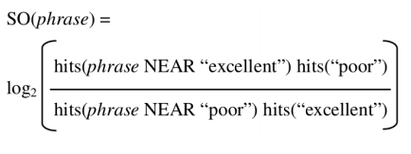
Calculating SO-PMI with a Search Engine
To avoid division by 0, 0.01 is added to hits(q).
Skip phrases where any hits(q) < 4.
Optimize the number of queries to run:

Slide 14
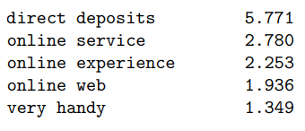
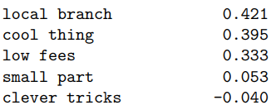
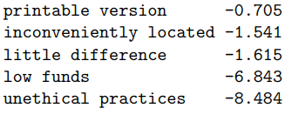
SO-PMI for Example Phrases

Slide 15
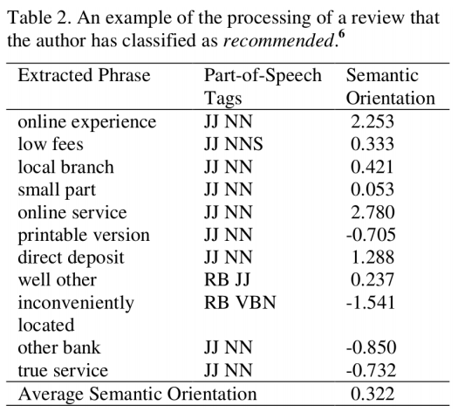
Step 3: Classify Review – Average over all Phrases
Notes:
The third step is to calculate the average semantic orientation of the phrases in the given review and classify the review as recommended if the average is positive and otherwise not recommended. Table 2 shows an example for a recommended review and Table 3 shows an example for a not recommended review. Both are reviews of the Bank of America. Both are in the collection of 410 reviews from Epinions that are used in the experiments in Section 4.

Slide 16
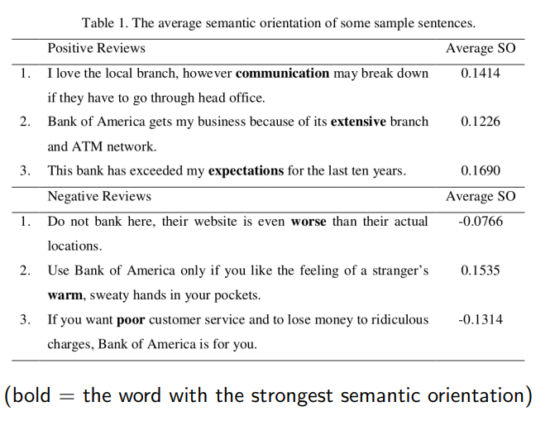
Examples of Sentence Classification

Slide 17
Summary of SO-PMI
Idea: Determine the semantic orientation (i.e., positive or negative polarity) of a phrase by the strength of its association with words of known semantic orientation.
Strength of association can be calculated using pointwise mutual information.
SO-PMI can be applied to phrases or words of any Part-of-Speech tag.
SO-PMI is simple and easy to implement, but needs very large corpora for good performance.
I Reported review classification accuracy with SO-PMI applied to phrases is about 74%.
Reported adjective classification accuracy for SO-PMI is around 87%–98% on large corpora.

